Slide 1
Good Governance
Governance refers to all processes of governing, the institutions, processes and practices through which issues of common concern are decided upon and regulated. Good governance adds a normative or evaluative attribute to the process of governing.

Slide 2
Good Governance Initiatives
PSGA
GPDP
Digital Services Initiative
B2V
IGRAMS
BEAMS Portal
EPM
E-office
RTI (Right to Information Act)

Slide 3
PSGA (Public Service Guarantee Act)
The PSGA, which was the first act of its kind in the world, guaranteed that citizens would receive specified public services within certain timeframes.
Objectives of the Act:
It aims at increasing transparency and public accountability.
It aims at empowering general public to enforce upon the administration their right of receiving prompt delivery of public services on various fronts of day-to-day life importance within a specified timeline.
It reduces the gap between Administration and People
It would nurture good governance in the State.
It would curb red-tapism.

Slide 4
GPDP (Gram Panchayat Development Program)
Gram Panchayat Development Plan (GPDP) has its own plan to be made by Gram Panchayats in J&k, in which Panchayats formulate a far-reaching action plan for 'Social Justice and Economic Development' of their area.

Slide 5
Digital Services Initiative
Adhaar Biometric
Digital Payments
CSC (Common Service Centers)
Digi Dost and Digi Sahayak
Mission Karmayogi
E-Compendium
Digitalization of Land Records

Slide 6
Adhaar Biometric
Biometric Attendance System based on Aadhaar Authentication
Attendance System with real time monitoring
Comprehensive MIS
Lightweight System- Does not requires any special hardware or algorithm
Works on multiple platforms (Windows, Android, etc.) and form factors(Desktop and Tablets, etc.)
Robust System- Self sustained for small power cuts
Time taken to Record Attendance: 1-2 Seconds on WiFi and 8-11 Seconds on GPRS (SIM)

Slide 7
AEBAS: Features
Simple to Deploy : No hardware locking
Any Tablet/PC on any OS
Fingerprint/Iris Scanner Device
Ready to use software ( installs within seconds)
Connectivity
Package Box
Affordable ( Total cost per device is less than Rs.10,000)
Portable and easily re-locatable
Fallback options for internet
Works on WiFi as well as GPRS, WiFi being the primary. In case of WiFi failure the system automatically switches to GPRS mode.
Remembers multiple WiFis.
Multiple Access Points : Employee marks attendance from any location/Office. A person working in State Office can mark his attendance in a District/Block Office
Online Self Registration requiring only Aadhaar, a scanned photograph and a working mobile number.
SMS Alerts to employees in case of absence, late coming, early leaving or not closing their attendance.

Slide 8
Advantages of AEBAS
Low cost – easily deployable
Will ensure attendance recording in remote areas with mobile connectivity
No attendance registers required
No cards or other tokens required
Comprehensive MIS
Employee cannot
Mark attendance in back-date
Mark someone else’s attendance
Can be used for live test of our pensioners
Tracks time of entry, exit hence MIS can track hours spent in office.
The whole AEBAS software is highly scalable.

Slide 9
Digital Payments
A digital payment, sometimes called an electronic payment, is the transfer of value from one payment account to another using a digital device or channel.
Benefit oriented schemes have been switched over to electronic payment mode.

Slide 10
CSC (Common Service Centers)
Common Service Centers (CSC) scheme provides a centralized collaborative framework for delivery of services to citizens through CSCs, besides ensuring systemic viability and sustainability of the Scheme.

Slide 11
DIGI Dost and DIGI Sahayak
Digi-Dost (Doorstep delivery of services), CSC-Aadhaar Seva Kendras at Block Level, on-boarding of 300 services on auto appeal system and Digi Sahayak, a multilingual chatbot will provide improved citizen-centric services to the people

Slide 12
Mission Karmayogi
In September 2020, Government of India has launched Mission Karmayogi a National Programme for Civil Services Capacity Building (NPCSCP). The programme aims at building a future-ready civil service with the right attitude, skills and knowledge, aligned to the vision of New India.

Slide 13
E-Compendium
E-Compendium portal having list of completed works and are put in public domain.

Slide 14
Digitization of Land Records
The Digital India Land Records Modernization Programme (DILRMP) is launched by Government of India in August 2008-09, aimed to modernize management of land records, minimize scope of land/property disputes, enhance transparency in the land records maintenance system, and facilitate moving eventually towards guaranteed conclusive titles to immovable properties in the country.

Slide 15
B2V (Back to Village)
Back to Village program is aimed to involve the citizens of the state and government officials in a joint effort to deliver the mission, to achieve equitable devolvement.

Slide 16
JK-IGRAMS
This portal has been developed to enable citizens to register their grievances and seek redress/ answers from the concerned departments. Though it has existed for past few years, an attempt has now been made to provide a single window for lodging; channelizing and tracking the grievances by integrating it with Govt. of India's CPGRAMS on top and District Grievance Cells of all 20 districts at bottom. Further, toll-free Call Centers have been set up for providing an alternate medium to the citizens to register their grievance at district level.

Slide 17
BEAMS (Budget Estimation Allocation Monitoring System)
The BEAMS web portal hosting all the works being executed in the UT is designed to capture the flow of funds to each individual project under execution on a real-time basis.

Slide 18
EPM (Employee Performance Monitoring Portal)
J&K Employees Performance Monitoring Portal. (EPM) http://epm.jk.gov.in. This portal has been designed to capture the monthly work performance of the employees and officers of the Government of Jammu & Kashmir and the appraisal thereof by their respective Reporting / Controlling Officers.

Slide 19
E-Office
The e-office has revolutionized the way our offices should be run . It is aimed at simplifying the process and making the system more responsive, effective and transparent. Its layout has been designed to make it usable at all levels. It brings together the independent functions and systems under a single framework.
Enhance transparency – files can be tracked and their status is known to all at all times
Increase accountability – the responsibility of quality and speed of decision making is easier to monitor.
Assure data security and data integrity.
Provides a platform for re-inventing and re-engineering the government.
Promote innovation by releasing staff energy and time from unproductive procedures.
Transform the government work culture and ethics.
Promote greater collaboration in the work place and effective knowledge management.
Flexible working .

Slide 20
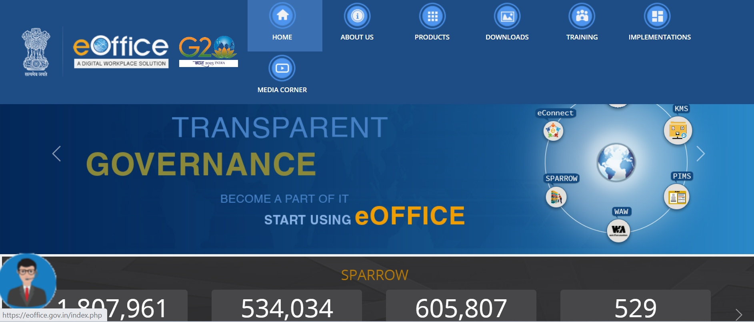
E-Office

Slide 21
Rights under the Act:
Access to the public service within stipulated time in transparent manner;
Enforce accountability of the Designated Officers for any lapse/deficiency in service ; and
Avail compensation for non-providing or deficiency in service.

Slide 22
Thanks

